Slide 1
Arduino Uno (R3) Pin Configuration & Installation
CSE 315
Peripherals & Interfacing
Credit:
Abdullah Al Omar
Lecturer, CSE, UAP

Slide 2
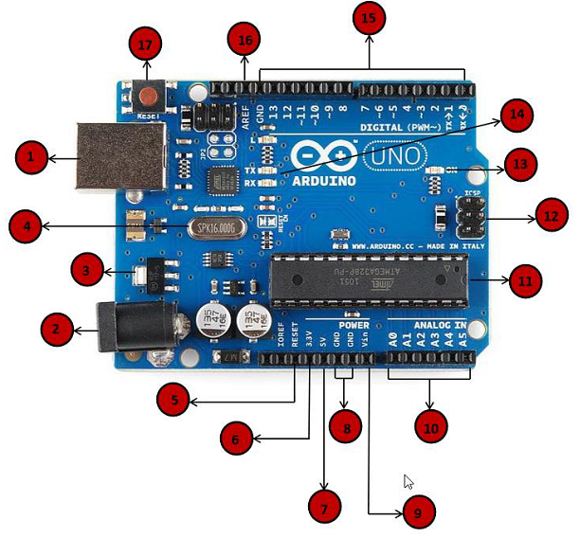
Pin Configuration

Slide 3

 | Power USB Arduino board can be powered by using the USB cable from your computer. All you need to do is connect the USB cable to the USB connection (1).

Slide 4

 | Power (Barrel Jack) Arduino boards can be powered directly from the AC mains power supply by connecting it to the Barrel Jack (2).

Slide 5

 | Voltage Regulator The function of the voltage regulator is to control the voltage given to the Arduino board and stabilize the DC voltages used by the processor and other elements.

Slide 6

 | Crystal Oscillator The crystal oscillator helps Arduino in dealing with time issues. How does Arduino calculate time? The answer is, by using the crystal oscillator. The number printed on top of the Arduino crystal is 16.000H9H. It tells us that the frequency is 16,000,000 Hertz or 16 MHz.

Slide 7

 | Arduino Reset You can reset your Arduino board, i.e., start your program from the beginning. You can reset the UNO board in two ways. First, by using the reset button (17) on the board. Second, you can connect an external reset button to the Arduino pin labelled RESET (5).

Slide 8

 | Pins (3.3, 5, GND, Vin) 3.3V (6) − Supply 3.3 output volt 5V (7) − Supply 5 output volt Most of the components used with Arduino board works fine with 3.3 volt and 5 volt. GND (8)(Ground) − There are several GND pins on the Arduino, any of which can be used to ground your circuit. Vin (9) − This pin also can be used to power the Arduino board from an external power source, like AC mains power supply.

Slide 9

 | Analog pins The Arduino UNO board has six analog input pins A0 through A5. These pins can read the signal from an analog sensor like the humidity sensor or temperature sensor and convert it into a digital value that can be read by the microprocessor.

Slide 10

 | Main microcontroller Each Arduino board has its own microcontroller (11). You can assume it as the brain of your board. The main IC (integrated circuit) on the Arduino is slightly different from board to board. The microcontrollers are usually of the ATMEL Company. You must know what IC your board has before loading up a new program from the Arduino IDE. This information is available on the top of the IC. For more details about the IC construction and functions, you can refer to the data sheet.

Slide 11

 | ICSP pin Mostly, ICSP (In Circuit Serial Programming) (12) is an AVR, a tiny programming header for the Arduino consisting of MOSI, MISO, SCK, RESET, VCC, and GND. It is often referred to as an SPI (Serial Peripheral Interface), which could be considered as an "expansion" of the output. Actually, you are slaving the output device to the master of the SPI bus.

Slide 12

 | Power LED indicator This LED should light up when you plug your Arduino into a power source to indicate that your board is powered up correctly. If this light does not turn on, then there is something wrong with the connection.

Slide 13

 | TX and RX LEDs On your board, you will find two labels: TX (transmit) and RX (receive). They appear in two places on the Arduino UNO board. First, at the digital pins 0 and 1, to indicate the pins responsible for serial communication. Second, the TX and RX led (13). The TX led flashes with different speed while sending the serial data. The speed of flashing depends on the baud rate used by the board. RX flashes during the receiving process.

Slide 14

 | Digital I/O The Arduino UNO board has 14 digital I/O pins (15) (of which 6 provide PWM (Pulse Width Modulation) output. These pins can be configured to work as input digital pins to read logic values (0 or 1) or as digital output pins to drive different modules like LEDs, relays, etc. The pins labeled “~” can be used to generate PWM.

Slide 15

 | AREF AREF stands for Analog Reference. It is sometimes, used to set an external reference voltage (between 0 and 5 Volts) as the upper limit for the analog input pins.

Slide 16
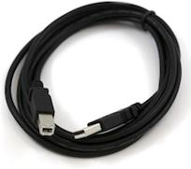
Step 1 − First you must have your Arduino board (you can choose your favorite board) and a USB cable. The kind you would connect to a USB printer as shown in the following image.
USB Cable

Slide 17
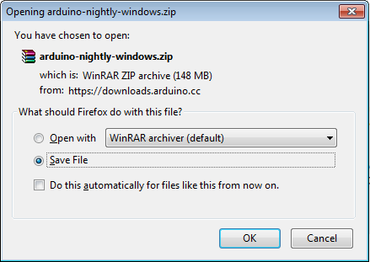
Step 2 − Download Arduino IDE Software.
You can get different versions of Arduino IDE from the Download page on the Arduino Official website. You must select your software, which is compatible with your operating system (Windows, IOS, or Linux). After your file download is complete, unzip the file.
Opening Arduino Nightly Windows

Slide 18
Step 3 − Power up your board.
Connect the Arduino board to your computer using the USB cable. The green power LED (labeled PWR) should glow.

Slide 19
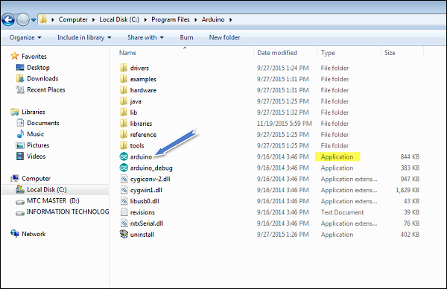
Step 4 − Launch Arduino IDE.
After your Arduino IDE software is downloaded, you need to unzip the folder. Inside the folder, you can find the application icon with an infinity label (application.exe). Double-click the icon to start the IDE.

Slide 20
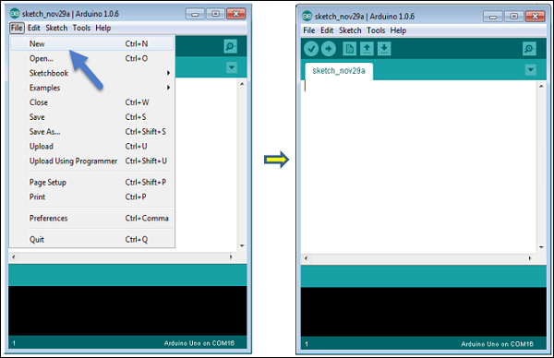
Step 5 − Open your first project.
Once the software starts, you have two options −
Create a new project.
Open an existing project example.
To create a new project, select File → New.

Slide 21
Step 6 − Select your Arduino board.
To avoid any error while uploading your program to the board, you must select the correct Arduino board name, which matches with the board connected to your computer.
Go to Tools → Board and select your board.

Slide 22
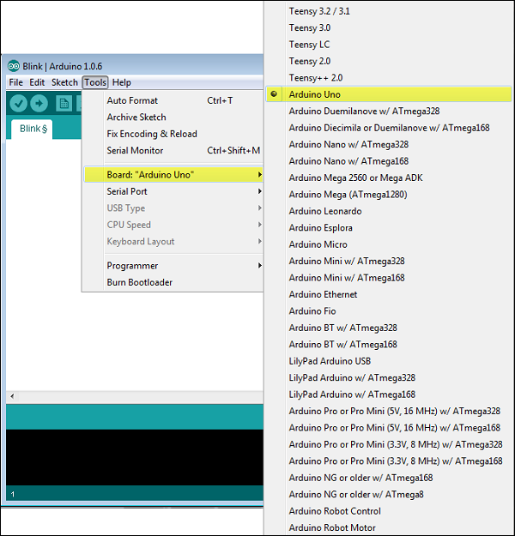

Slide 23
Step 7 − Select your serial port.
Select the serial device of the Arduino board. Go to Tools → Serial Port menu. This is likely to be COM3 or higher (COM1 and COM2 are usually reserved for hardware serial ports). To find out, you can disconnect your Arduino board and re-open the menu, the entry that disappears should be of the Arduino board. Reconnect the board and select that serial port.

Slide 24
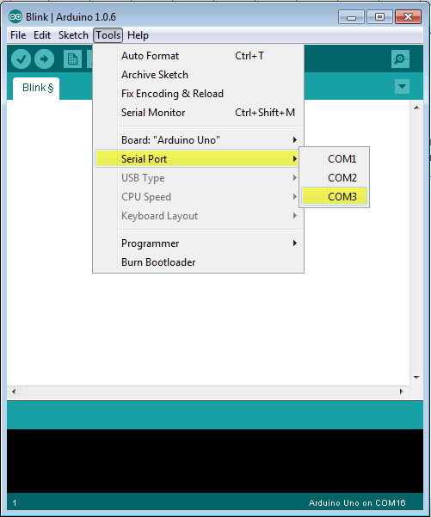

Slide 25
Step 8 − Upload the program to your board.
Before explaining how we can upload our program to the board, we must demonstrate the function of each symbol appearing in the Arduino IDE toolbar.

Slide 26
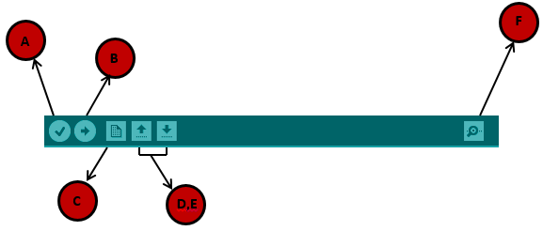
A − Used to check if there is any compilation error.
B − Used to upload a program to the Arduino board.
C − Shortcut used to create a new sketch.
D − Used to directly open one of the example sketch.
E − Used to save your sketch.
F − Serial monitor used to receive serial data from the board and send the serial data to the board.

Slide 27
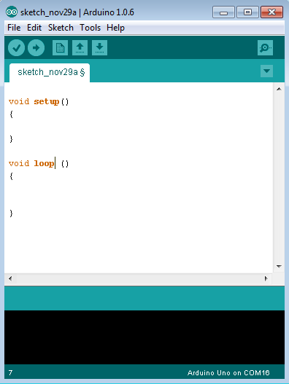
Your First Program on Arduino UNO:

